Slide 1
Non-Coherent Digital modulation
Prepared by
G. Balamurugan, MIT Campus

Slide 2
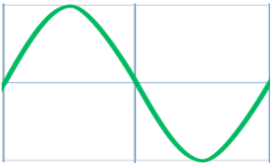
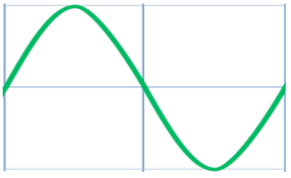
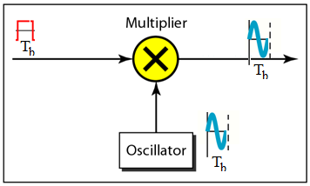

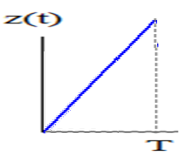
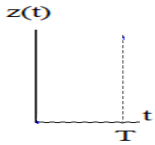
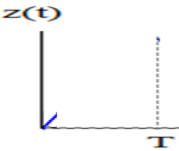
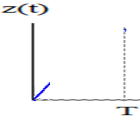
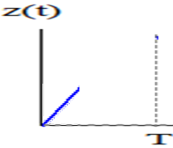
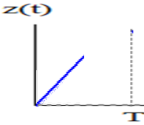
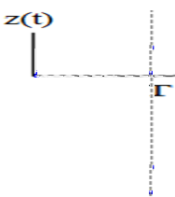
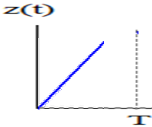
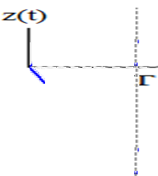
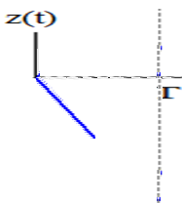
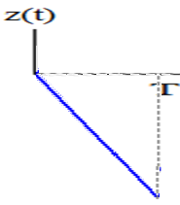
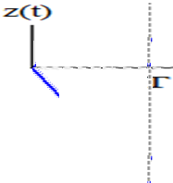
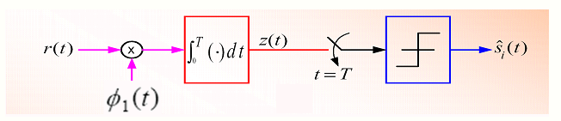


Coherent and Non-Coherent
Coherent Detection– [ Need a synchronous carrier at Receiver]
When the receiver exploits knowledge of the carrier phase to detect the signals, the process is called coherent detection.
Non-coherent Detection – [ Does not need a synchronous carrier at Receiver]
When the receiver does not utilize such phase reference information, the process is called non-coherent detection.

Slide 3
Non-coherent receivers
Differential Phase-Shift Keying (DPSK )
Binary Frequency-Shift Keying (BFSK)

Slide 4
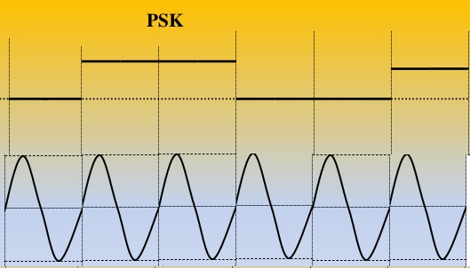
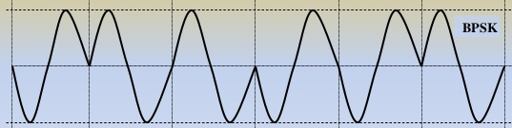
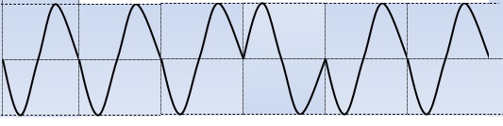
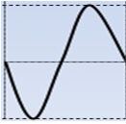
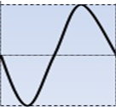
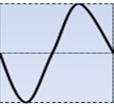
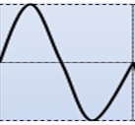
1. DPSK
Non-coherent version of PSK – [ Does not need a synchronous carrier at Receiver]
Phase synchronization is eliminated using differential encoding
Encode the information in phase difference between successive signal transmission. In effect,
to send “0”, advance the phase of the current signal by 180 degree
to send “1”, leave the phase unchanged
Whenever it is ‘0’ output add phase shift of 180 degree

Slide 5

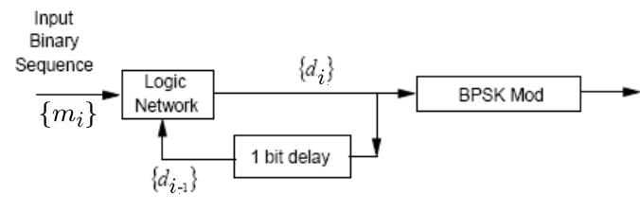
Generation of DPSK
Generate DPSK signals in two steps
Differential encoding of the information binary bits
Phase shift keying
Transmitter:
i=0
i=1
i=2
i=3
i=4
i=5
i=6
i=7
i=8
Information sequence {mi} |  | 1 | 0 | 0 | 1 | 0 | 0 | 1 | 1
Differentially encoded sequence {di}
Transmitted Phase
1
1
0
1
1
0
1
1
1
Initial Bit
0
0
Pi
0
0
Pi
0
0
0
Try to encode the Message bit : 1 0 0 1 0 1 1 0

Slide 6
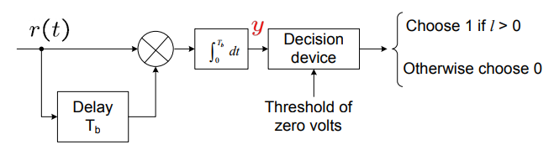



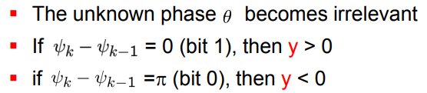
Detection of DPSK
Receiver:
Output of the integrator ( assume noise free)

Slide 7
Bandwidth
Since one previous bit is used to define phase shift in next bit, the symbol can have two bits.
One symbol duration is equivalent to two bits duration.
T= 2Tb
Bandwidth of BPSK is 2fb
Bandwidth = 2fb
= 2 / T
= 2 / 2Tb
= 1 / Tb
Bandwidth DPSK= fb

Slide 8
DPSK Summary
Advantage:
Does not require carrier at the receiver. So complicated circuit for generation of local carrier is avoided.
Bandwidth of DPSK is reduced compared to BPSK.
Disadvantage:
DPSK uses two successive bits for its reception. The error in the first bit creates error in the second bit. Hence error propagation is more.
Therefore probability of error for DPSK is more compared to BPSK.

Slide 9
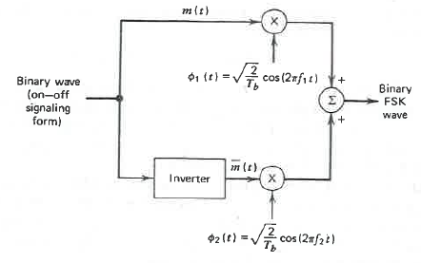
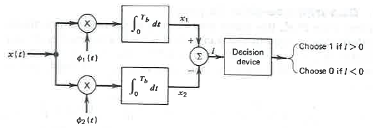
2. BFSK (Coherent)
Transmitter:
Receiver:

Slide 10
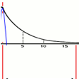
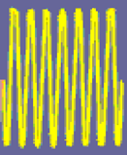
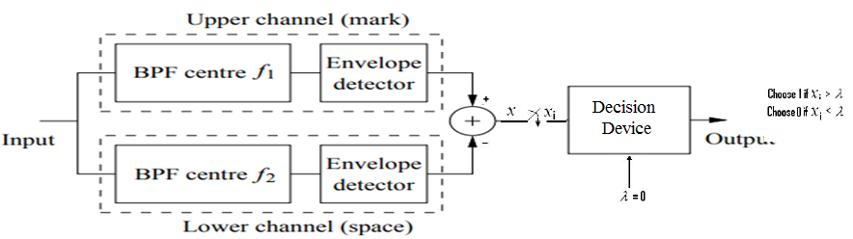
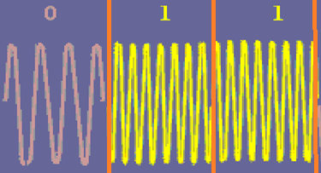

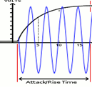
2. BFSK (Non-Coherent)
In non-coherent detection, the receiver consist of pair of matched filters followed by envelop detectors.
Filter in the upper path is matched to f1 and lower path is matched to f2.
Resulting Envelope detector outputs are sampled at T.
Compare the energy in the two frequencies and pick the larger.
Receiver

Slide 11
Quadrature Amplitude Modulation (QAM)

Slide 12
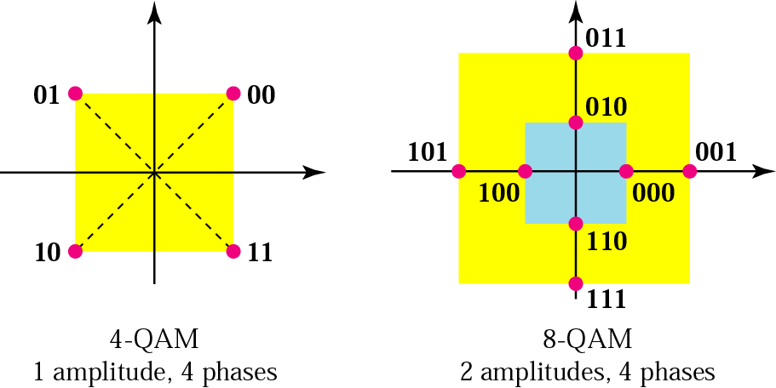
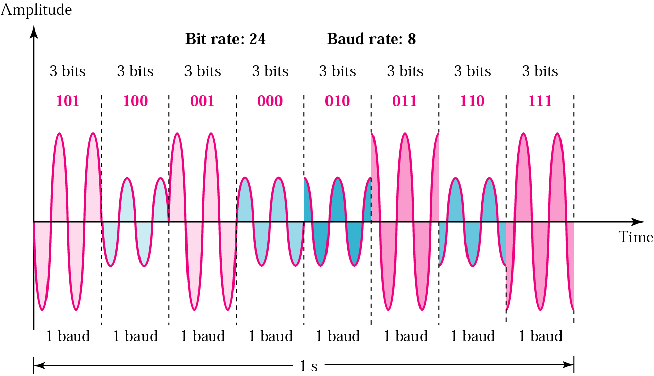
QAM Principle
Quadrature Amplitude Modulation is a signal in which two carriers shifted in phase by 90 degrees are modulated and the resultant output consists of both amplitude and phase variations.
Quadrature amplitude modulation is a combination of ASK and PSK
Quadrature amplitude modulation is widely used in many digital data radio communications and data communications applications.
For domestic broadcast applications for example, 64 QAM and 256 QAM are often used in digital cable television and cable modem applications.

Slide 13
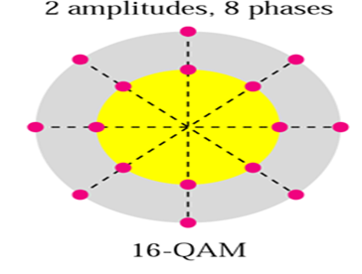
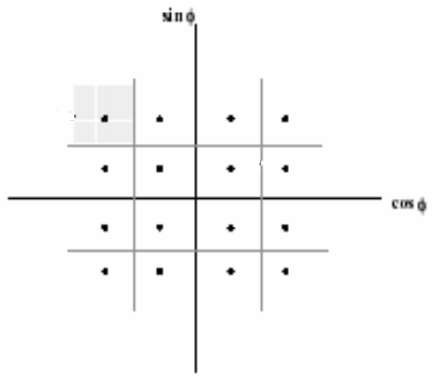
QAM Principle
Advantage:
Increase the efficiency of transmission for radio communications systems by utilising both amplitude and phase variations,
Disadvantage:
More susceptible to noise because the states are closer together

Slide 14
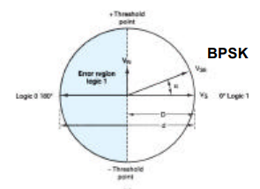
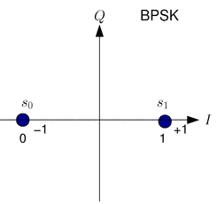
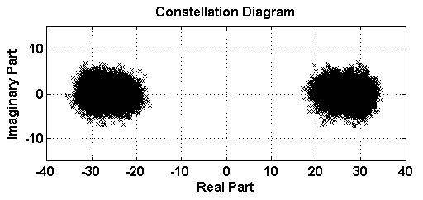
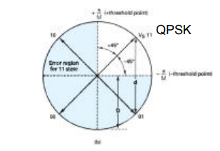
M-ary Error Performance
A received symbol is decoded into the closest the symbol in the signal constellation
As the number of symbols in the signal space increases the decoding region for each symbol decreases

Slide 15
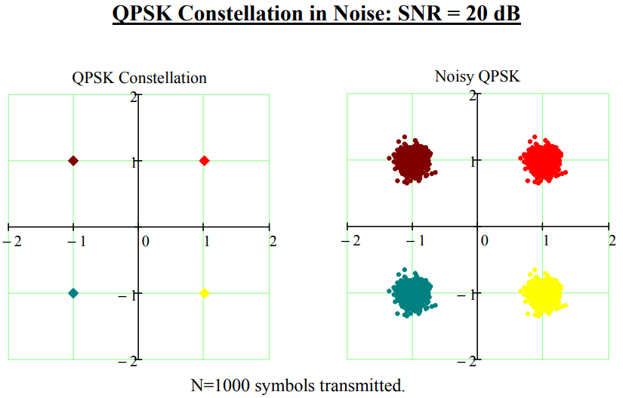

Slide 16
